Slide 1

Computation of resonant modes in cavities with a Discontinuous Galerkin time domain approach
ACME 2015
Mark Dawson
Rubén Sevilla
Oubay Hassan
Kenneth Morgan

Slide 2
Outline
Motivation
Governing Equations
Numerical Method
Parallelisation
Dispersive Materials
Obtaining Resonant Frequencies & Mode Shapes
Numerical Examples
Conclusion

Slide 3
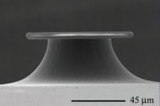
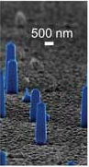
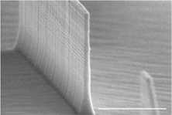
Motivation
An optical resonator is a cavity which can confine light spatially at its resonant frequencies.
[1]
Uses in:
Nanocavity lasers on optical integrated circuits
Highly selective add-drop wavelength filters
Optical memory
Optoelectronic biological sensing
Interesting due to:
Small scale
High quality factors
Well defined resonant frequencies
Large Free Spectral Range
[2]
[3]
[1] Science 10 August 2007: Vol. 317 no. 5839 pp. 783-787
[2] Nanophotonics, vol. 1, no. 1, pp. 23--29, Jan. 2012
[3] Optics Express, Vol. 17, Issue 13, pp. 11107-11112 (2009)

Slide 4
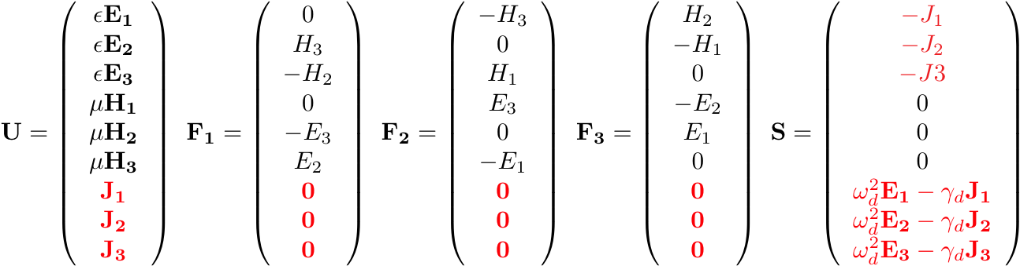
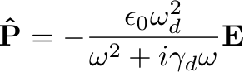
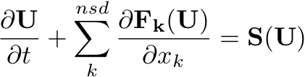
Governing Equations
Mention that a dispersive material has maerial parameters which depend on frequency, mention how in the frequency domain this is trivial. Say what the polarisation vector is, (very, very briefly) how it arises from material finite response time, is obtained directly from the drude model and outline the meaning of quantities omega and gamma (briefly). Mention how a transform to time domain results in a coupled ODE and show the final resulting total system.
Nanoresonators are well modeled by Maxwell’s equations of classical electromagnetics, which can be written in conservation form as:
Dispersion in the material can be accounted in the frequency domain by a polarisation vector:
And in the time domain this leads to an coupled ODE, the resulting system of equations is:

Slide 5
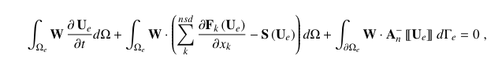
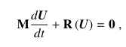
Discontinuous Galerkin Method
Multiply by a test function and integrate by parts twice
Use a flux splitting technique and choose an upwind numerical flux
Discreitse domain with an unstructured mesh and approximate the solution on each element as a sum of high-order, piecewise polynomial shape functions.
Choose Galerkin test functions W to be the same as the shape functions.
Resulting system in matrix form :

Slide 6
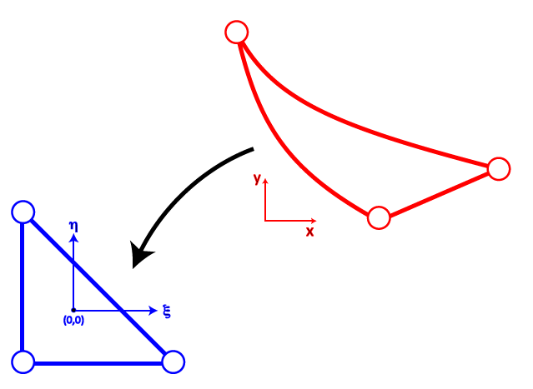
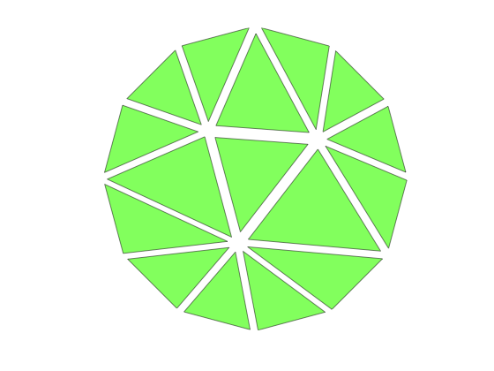
Discontinuous Galerkin Method
Unstructured mesh
Integrate in time using RK4 method
Block diagonal system
Nodal formulation
High-order shape functions
Discontinuous between elements
Polynomial approximation of domain boundary
Explicit time marching
Integration on gauss points using a reference element
Relatively easily parallelised

Slide 7
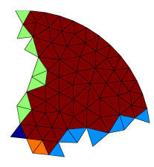
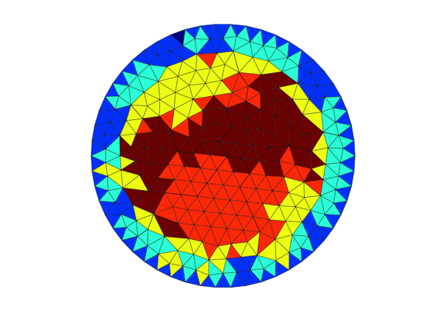
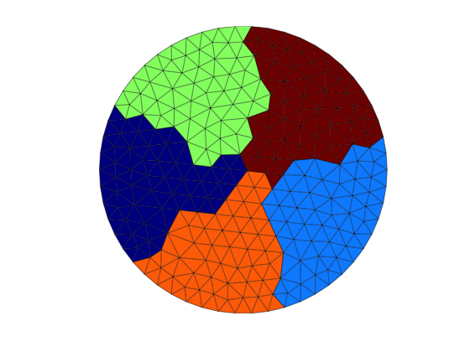
Parallelisation
Mention (very briefly) that we’ll see later that long times are necessary – justify the need for Parallelisation.
Bottom Left:
Talk about the issues of element ordering (contribution to face integral from gauss points need to be summed in the correct order so that numerical flux contributions are equal).
Bottom Right:
briefly mention the partitioning of X and T – and how data node coordinates are used and reordered to calculate faces integrals.
Elements are connected by boundary integral only so elements can be divided between multiple processors and solution values communicated at each time step.
Create an initial partitioning between processors, based on node number
Read information on allocated elements and determine neighboring elements
Use Parmetis library to minimise the number of external faces in each domain
Exchange shared-face information with other processors
Determine data partition of elements, local element numbering and communication pathways for each processor.
Advance solution in each domain
Communicate the solution values for boundary elements at each timestep
Notes:
Message: Galerkin is easy to parellise
Talk about how the equation shows that the --- is easy to parallise
Each processor reads a part of the mesh
Optimise partitions to minimise communication
Redistribute elements between processors
Redundantly data partition
Communication at ever stage of the RK4
Paritioned domain (split into sections)…who knows…
Illustration of elements on either side of boundary + comms
Contributions to the fluxes on elements on different processors either side of the boundary….
Addition problems
Simple to parellise due to local element matrices

Slide 8
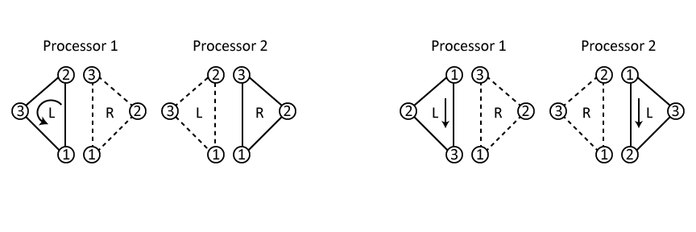
Parallisation Challenges
Gauss point summation order
Face integral must be calculated in the same direction on both processors
A + B ≠ B + A
Integration direction is fixed by assigning an element on a boundary face with respect to which the direction is taken.
Local node information
Nodal coordinates and connectivities exist only for local elements.
Nodal coordinates of non-local elements obtained by re-ordering local elements.

Slide 9
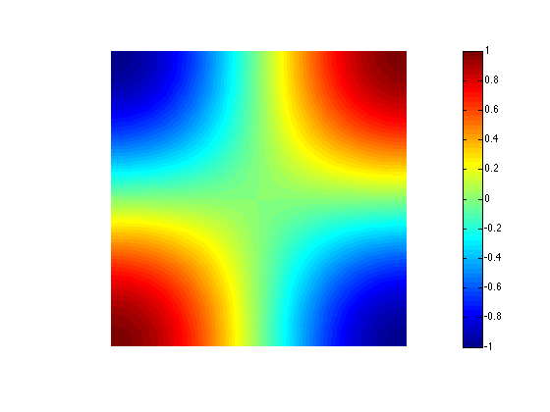
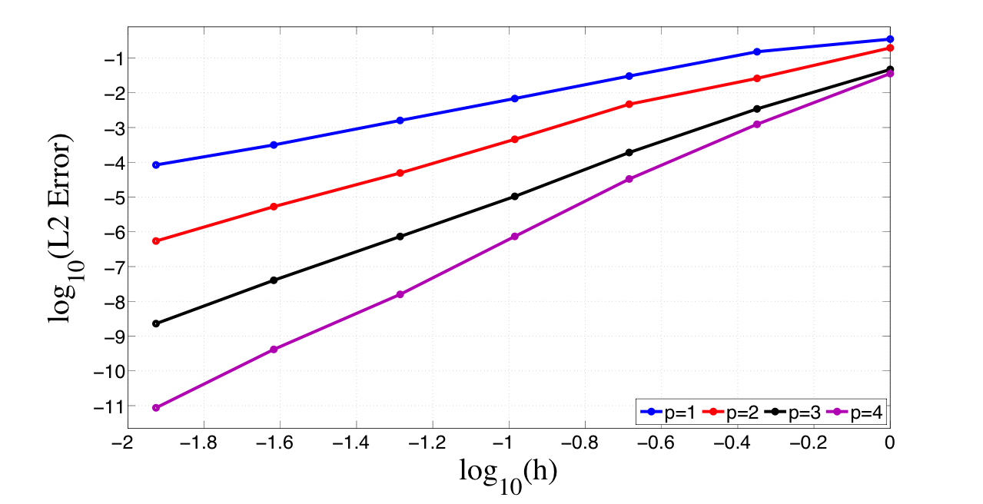
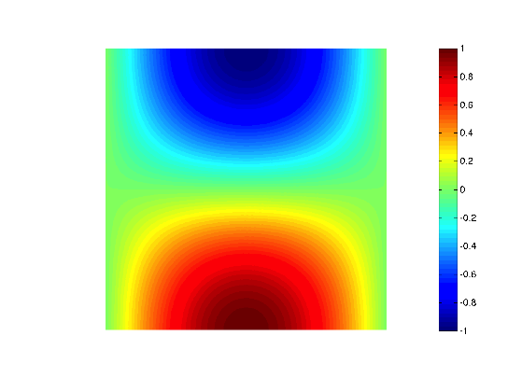
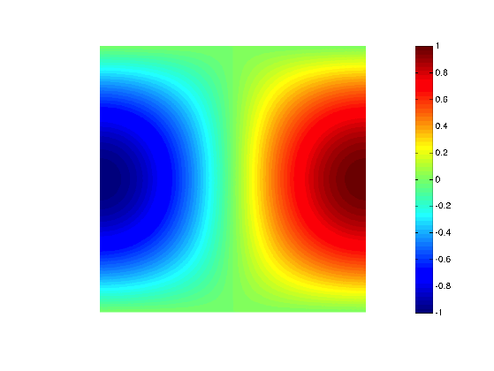
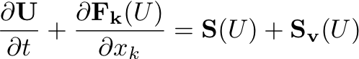
Dispersive Material Example
Governing equations modified with additional source term:

Slide 10
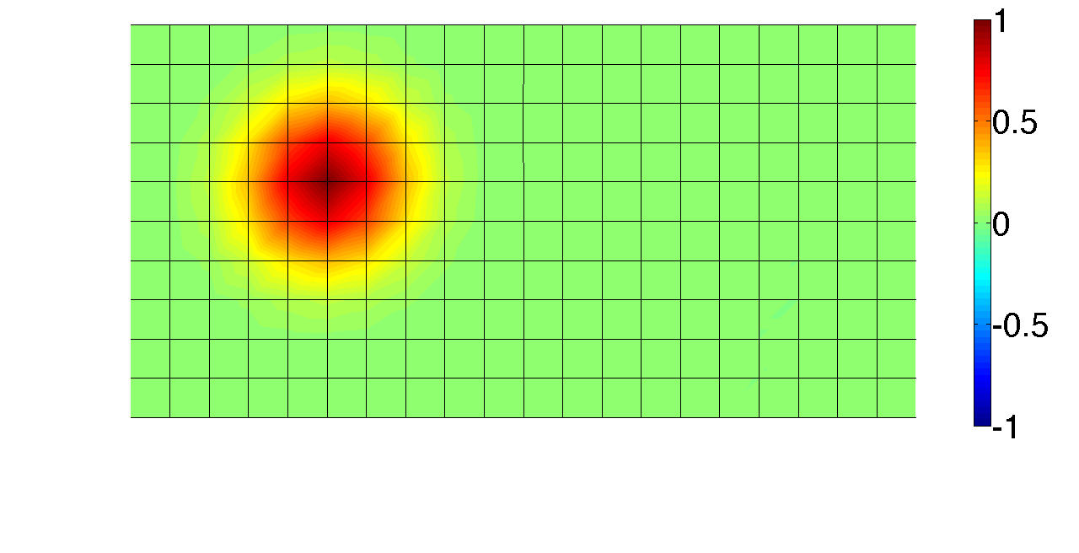
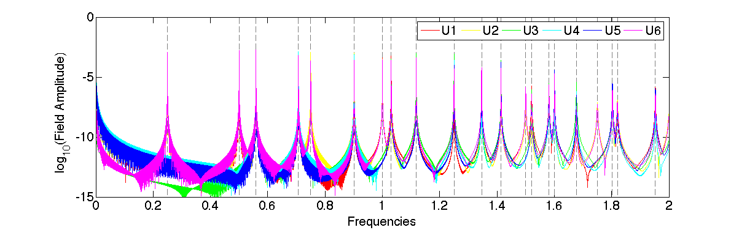
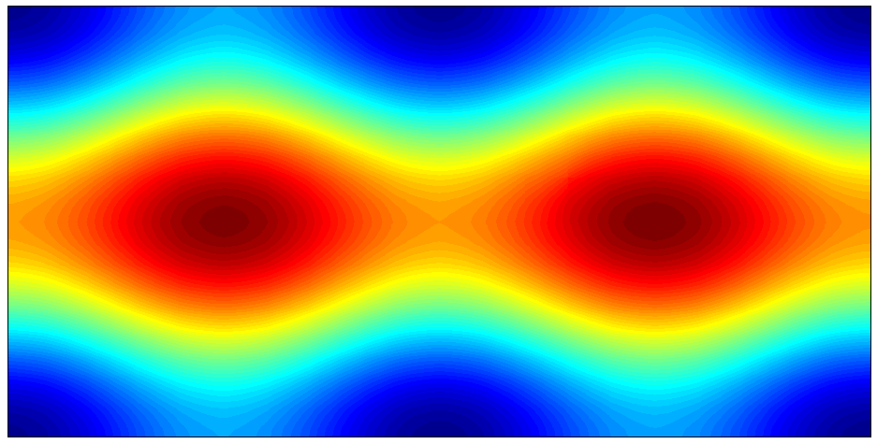
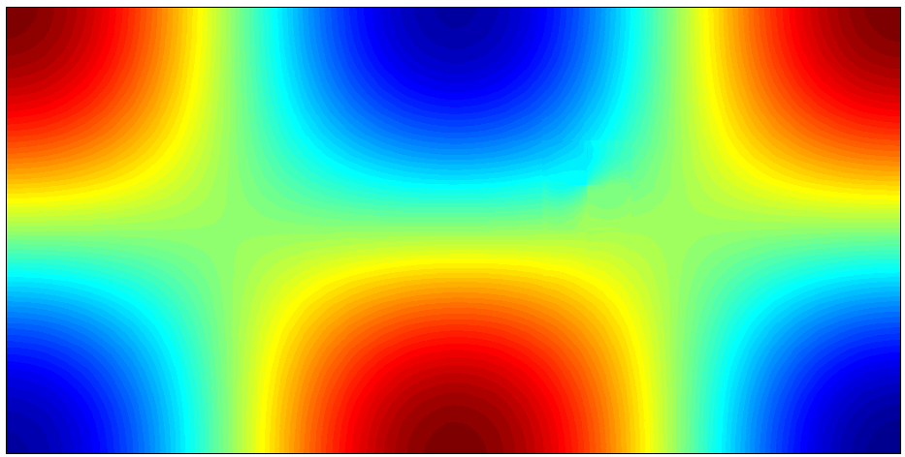
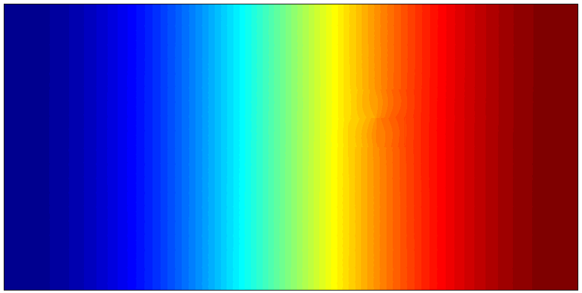
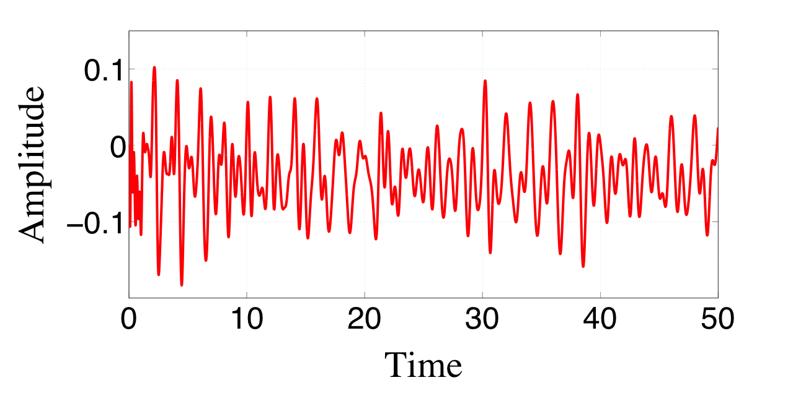
Computing Resonant Frequencies
Cavity initial condition
Recorded Solution at a point
Intensity spectrum

Slide 11
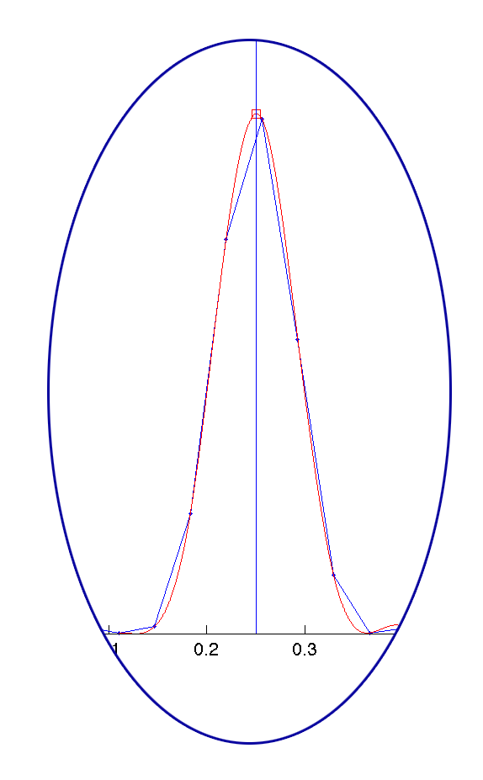
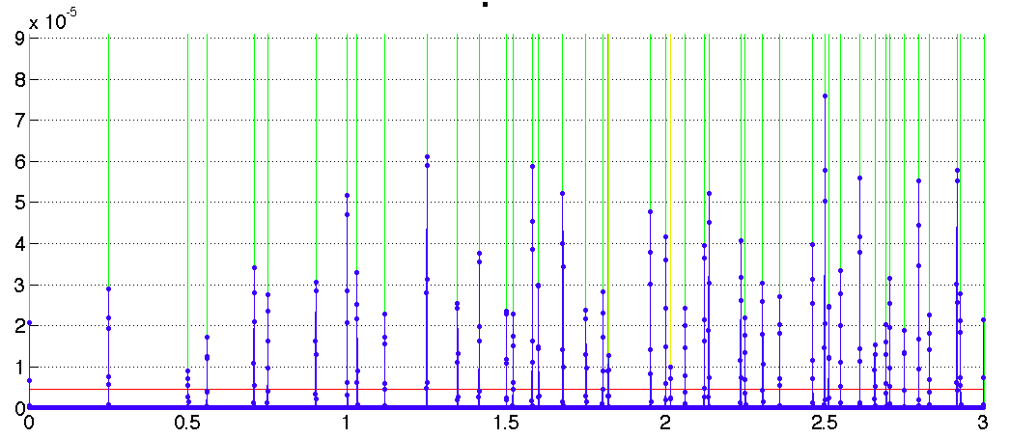
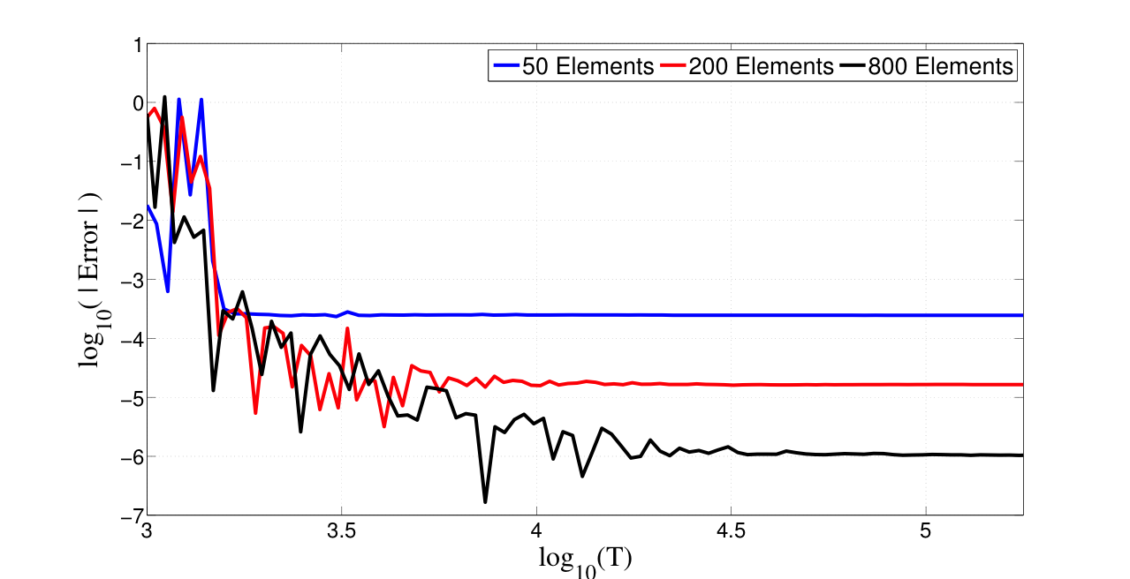
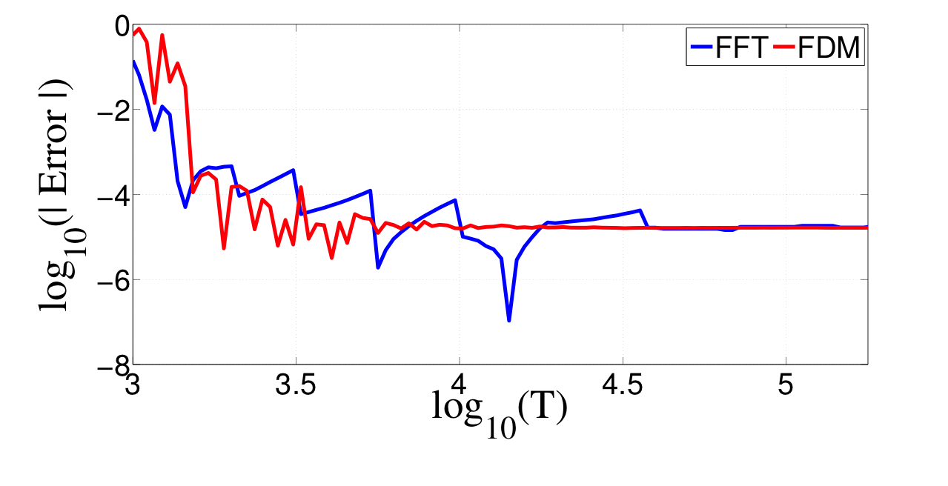
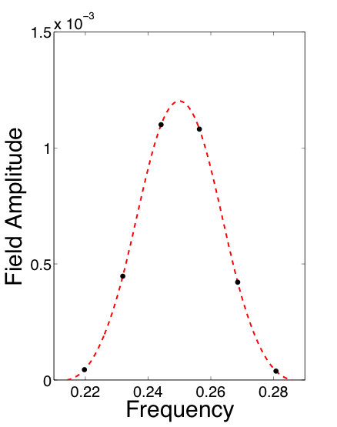
Improving Resolution
Resolution of the final spectrum determined by the simulation final time
Discuss how accuracy is affected by final time. Mention how parallelisation helps achieve this.
Discuss FDM improvement – use the fitting of the FFT as (additional) motivation.
I would like to put an animation here showing visually how a section of the spectrum (maybe one or two peaks) convergence with time.
Parameter methods, such as Filter Diagonalisation Method, achieve better accuracy in a shorter time

Slide 12
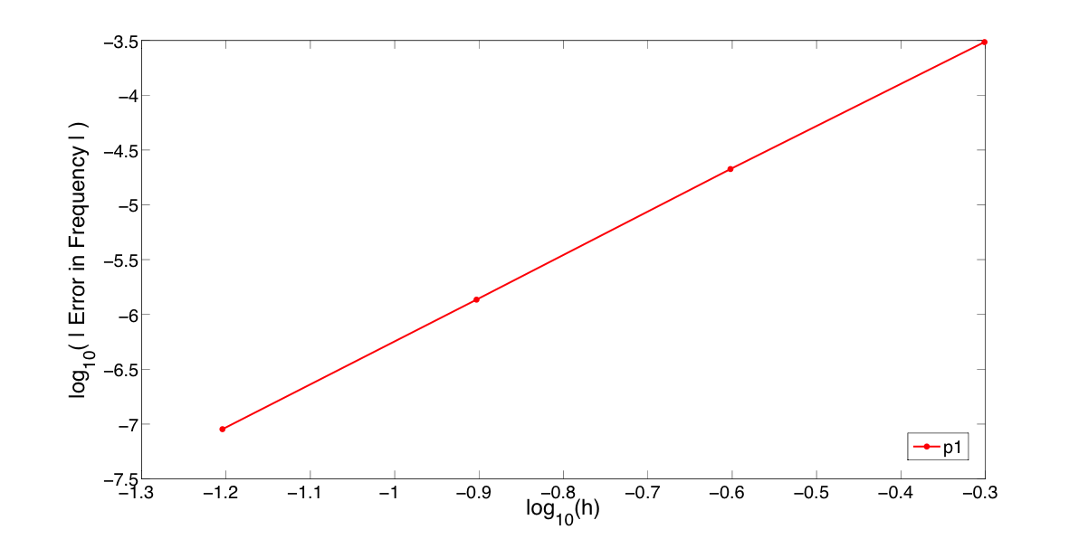
Scheme Convergence
Scheme accuracy converges with mesh size in space as 2(p+1), as expected from the dispersion error.
Hopefully there will be more results for this section before the conference.

Slide 13
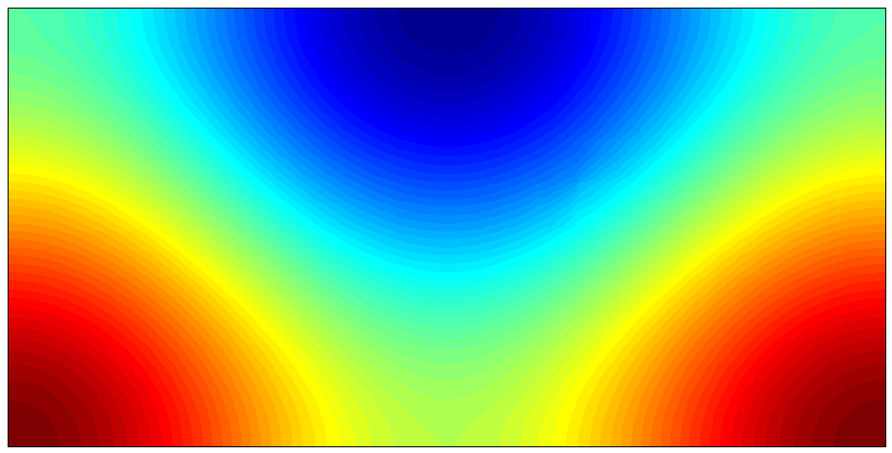
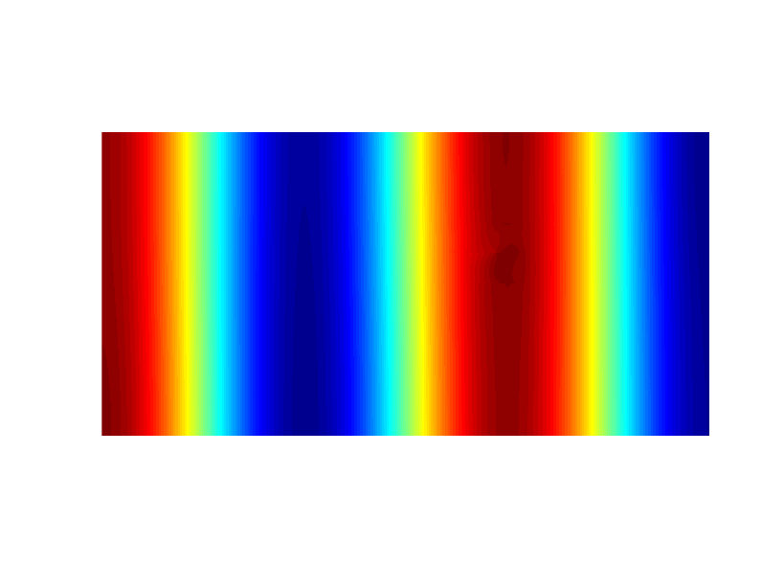
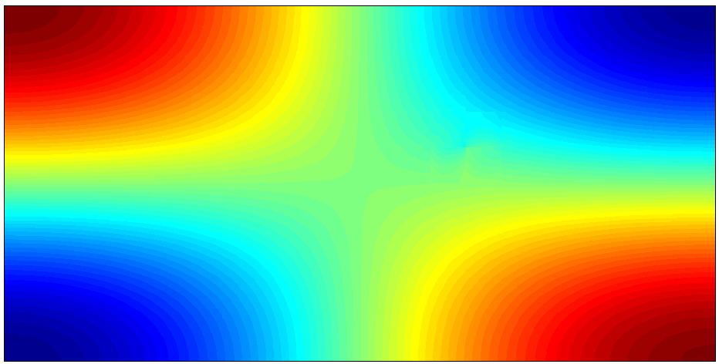
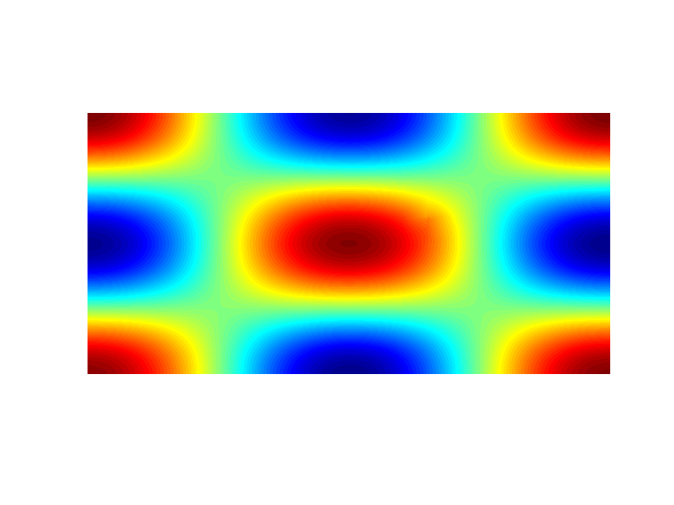
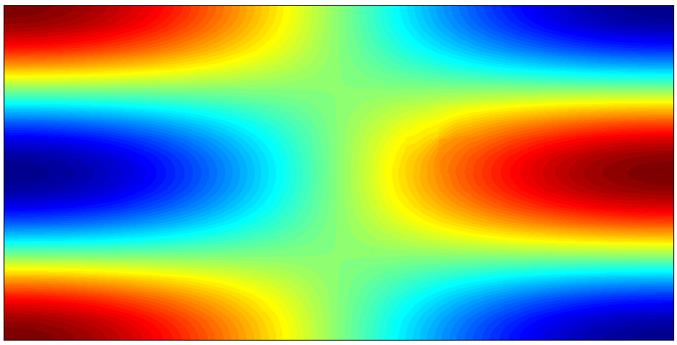
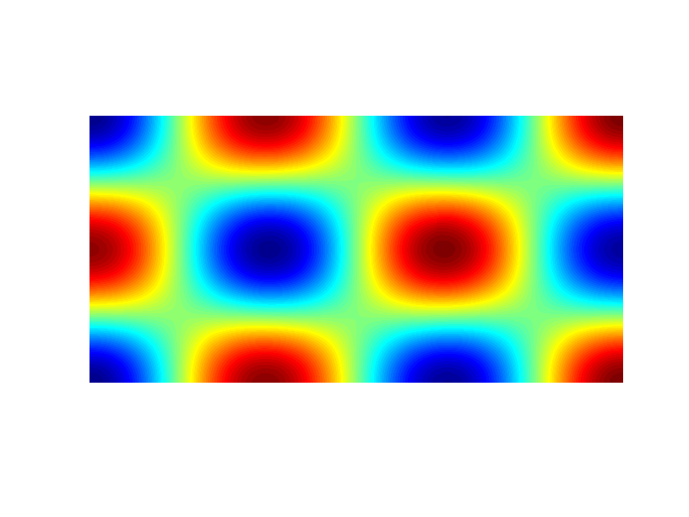
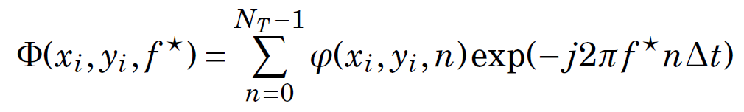
Obtaining Mode Shapes
Mode shapes can be obtained by running the time domain solver with a built in DFT

Slide 14
Conclusions
Conclusions
Method for obtaining resonant frequencies, quality factors and mode shapes.
Dispersive media implementation
Validation against analytical for a simple test case
Future Work and Objectives
Simulation of a real 3D dispersive cavities
Study effect boundary representation with Nurb-Enhanced Finite Element Method

